Slide 1
First Day Information

Slide 2
Where am I?
PSYC 3303 – Writing in Psychology
TR 12:30pm – 1:50pm

Slide 3
Who is this person? (1)
Dr. Maxwell
Contact: nicholas.maxwell@msutexas.edu
Office hours: 2:00pm – 4:30pm, TR (right after class!)
Location: OD 118

Slide 4
Who is this person? (2)
Cognitive Psychologist:
  Super interested in memory, language, and best science practices (research ethics, etc.)
  Loves research!

Slide 5
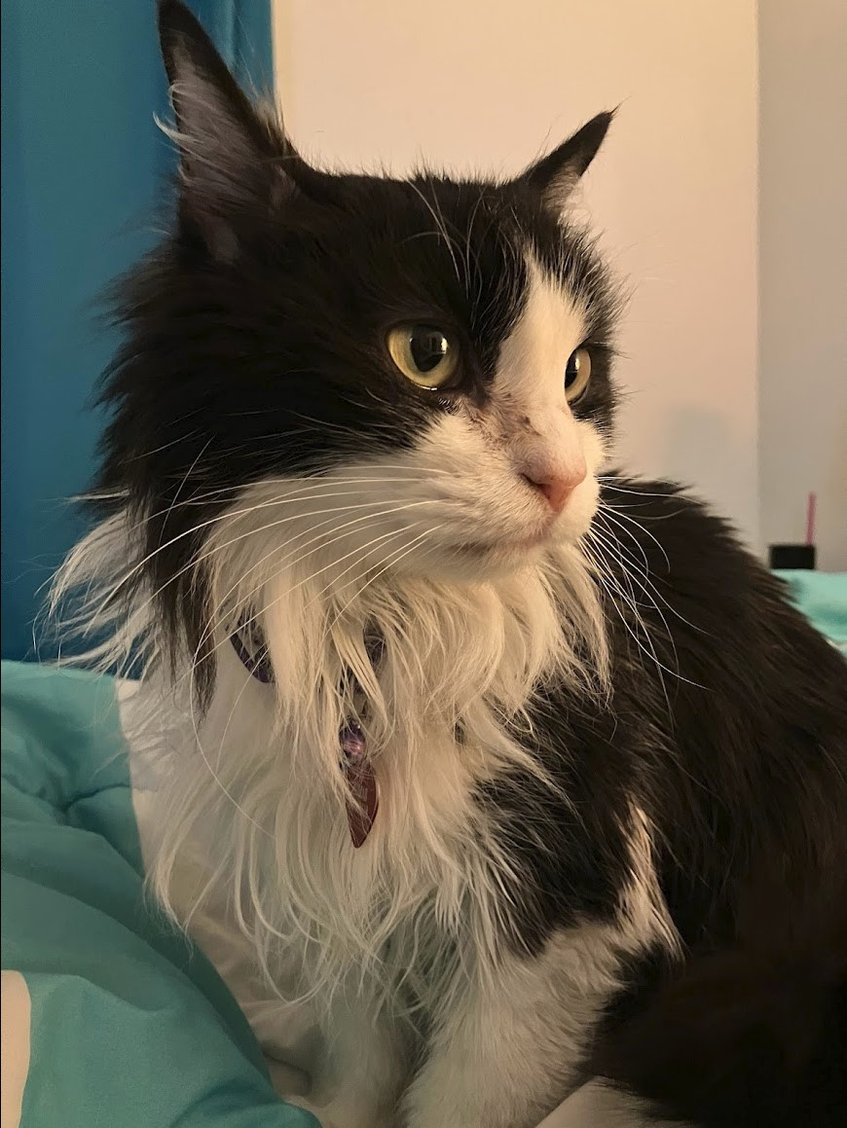

Who is this person? (3)

Slide 6
What do I get out of this Class? (1)
Understand how to use electronic databases to find research articles
Know the essentials of APA writing
Be able to write an APA style research paper describing a topic in depth

Slide 7
What do I get out of this Class? (2)
By the end of this class:
  Be able to write in APA style
  Understand the research/publication process
  Think analytically!

Slide 8
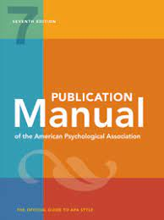
What will I Need?
Textbook: Publication manual of the American Psychological Association (7th edition)
Something to take notes with
Yourself! ☺

Slide 9
What’s expected of you?
  Lots of writing!
    Class is centered around 1 paper:
      Topic Proposal + Annotated Bibliography + Two Working Drafts + Final Paper
  Two exams covering APA basics, best practices for writing etc.

Slide 10
Term Paper (1)
10 – 12 page term paper
  Pick a topic in psychology
  Find at least 10 peer reviewed, empirical journal articles on this topic (Studies!)
  Summarize + compare and contrast
  How do articles support/discredit your position?
Final Submission Due: 12/11 @ *8:ooam*
Final submission == 200 Total Points
  Rubric posted on D2L

Slide 11
Term Paper (2)
Topic Approval
  You will submit your term paper topic for approval by email no later than Tuesday, 9/12
  List of topics posted on D2L
  Next week – OPTIONAL 1 on 1 meetings to discuss your topic idea with me
    10 bonus points on proposal submission
    No class on 9/5

Slide 12
Term Paper (3)
Annotated Bibliography (100 points)
  Create an APA style reference page listing each citation
  Provide a brief summary of each article (300-500 word)
    What is the main research question?
    What are the main findings?
    What did the authors conclude?

Slide 13
Term Paper (4)
Drafts – You will submit two drafts of your paper over the course of the semester
  Draft 1: Due 10/13 (100 points)
  Draft 2: Due 11/21 (100 points)
All drafts need to be submitted via D2L by 11:59pm on the day they are due
Final term paper is due : Monday 12/11 @ 8:00am (200 Points)

Slide 14
Term Paper (5)
First Draft: Full rough draft. Should contain all 10 citations. This is your time to put ideas on paper. Grade is based on length, citations, ability to stay on topic, etc.
Second Draft: A revised first draft. Grade is based on quality of revisions, strength of argument, adherence to APA style, as well as criteria for draft 1
Final Draft: Address any requested revisions. Grade is based on all criteria for drafts 1 and 2, plus clarity of writing, tone, and quality of sources.

Slide 15
Course Structure
Mix of lecture days and writing days
  Lectures: Analytical Writing, APA Style, and Research Best Practices
Writing days provide important opportunities to work on your term paper in class and receive feedback
  Peer editing!
  Feedback from me!
  Important! You will only be able to accomplish so much during writing days. To do well in this class, you will need to dedicate a few hours each week to writing. DON’T WAIT UNTIL THE LAST MINUTE!

Slide 16
Attendance Policy
Attendance is required
But if you do have to miss…
  Check D2L for slides
  Email me within 24 hours if you miss an exam
  Term Paper Drafts and Final Submission: -10 points per day late

Slide 17
Questions so far?

Slide 18
Now let’s do stuff!
Name:
Hometown/State:
Why are you taking this class? What do you hope to gain from this class?
Something fun you did over the summer?

